Slide 1



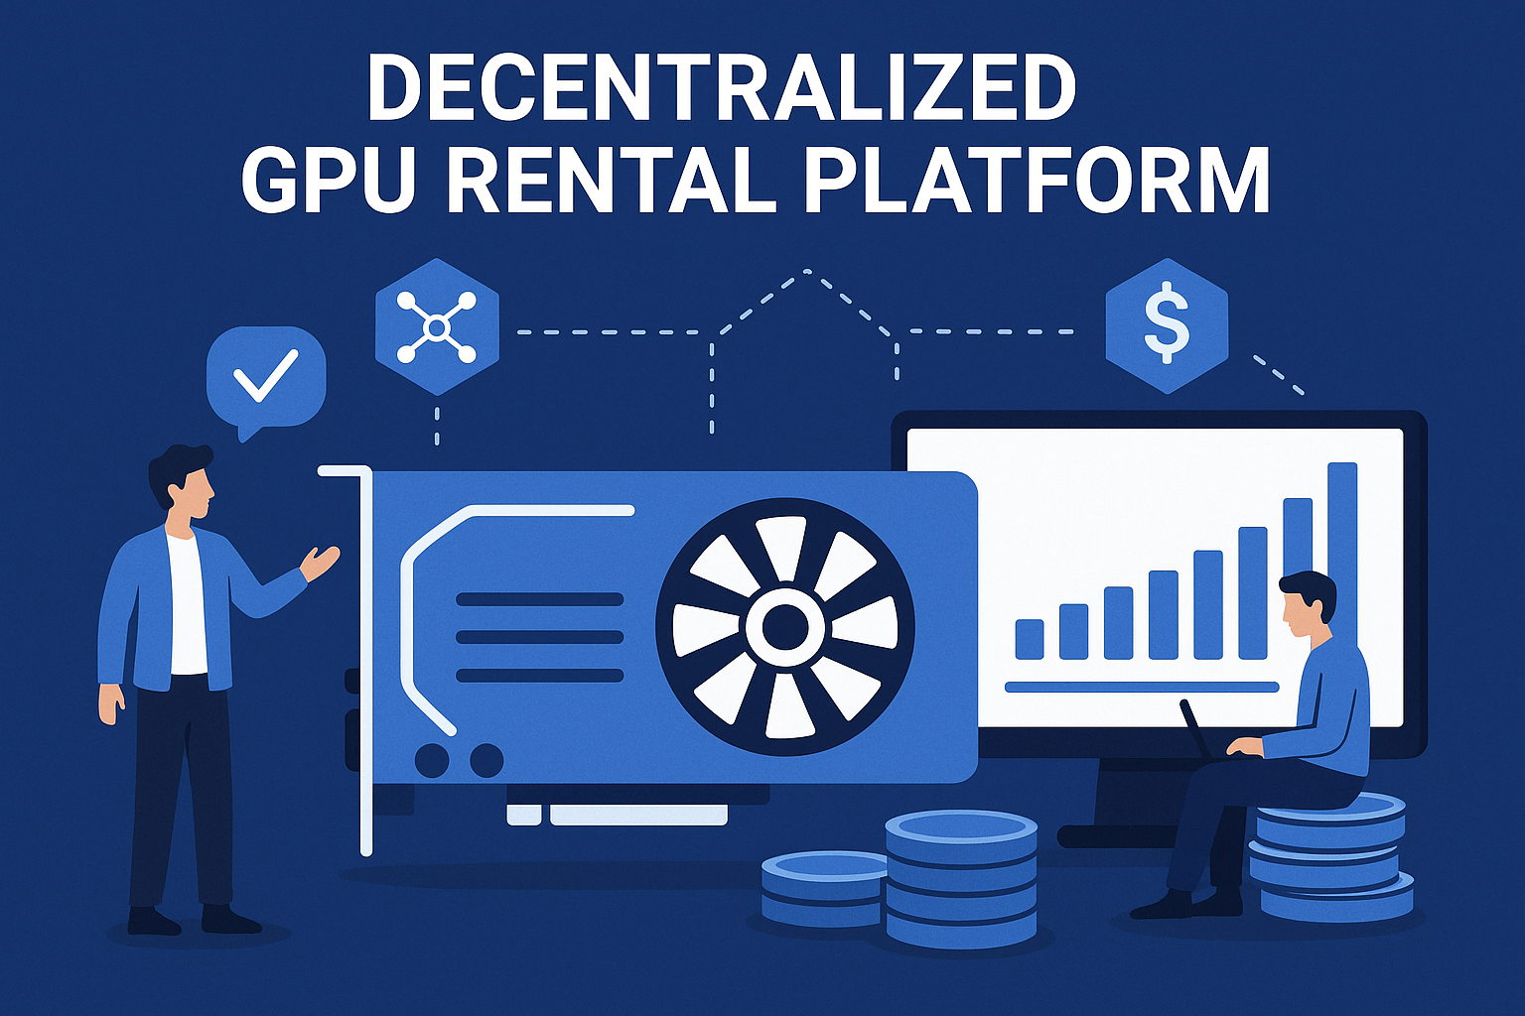



Decentralized GPU Rental Platform:
Revolutionizing GPU Rentals with
Blockchain & Automated Verification
Presented By:
Narayana Phani Charan Nimmagadda
Sai Madhukar Vanam

Slide 2



The Growing Need
In the booming fields of AI and Machine Learning, access to high-performance GPUs is critical.
But current GPU rental systems face major challenges...

Slide 3

Challenges in Traditional GPU Rentals
1. Trust Issues – No way to verify promised GPU performance
2. Payment Fairness – Full payment despite poor performance
3. Centralization – Intermediaries increase costs & complexity
4. Lack of Transparency – No clear verification of specs & metrics

Slide 4

Our Solution
- Smart Contract Escrow – Payment held until performance is verified
- Automated Verification – Chainlink Functions ensure fairness
- Fair Payment Distribution – Pay based on delivered performance
- Decentralized Storage – IPFS for secure, immutable data
- Complete Transparency – All actions recorded on blockchain

Slide 5
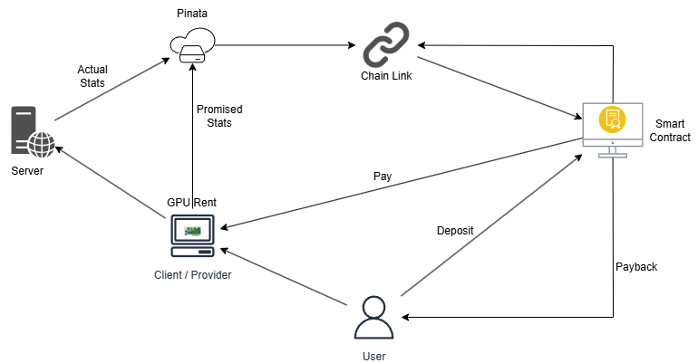

System Architecture

Slide 6


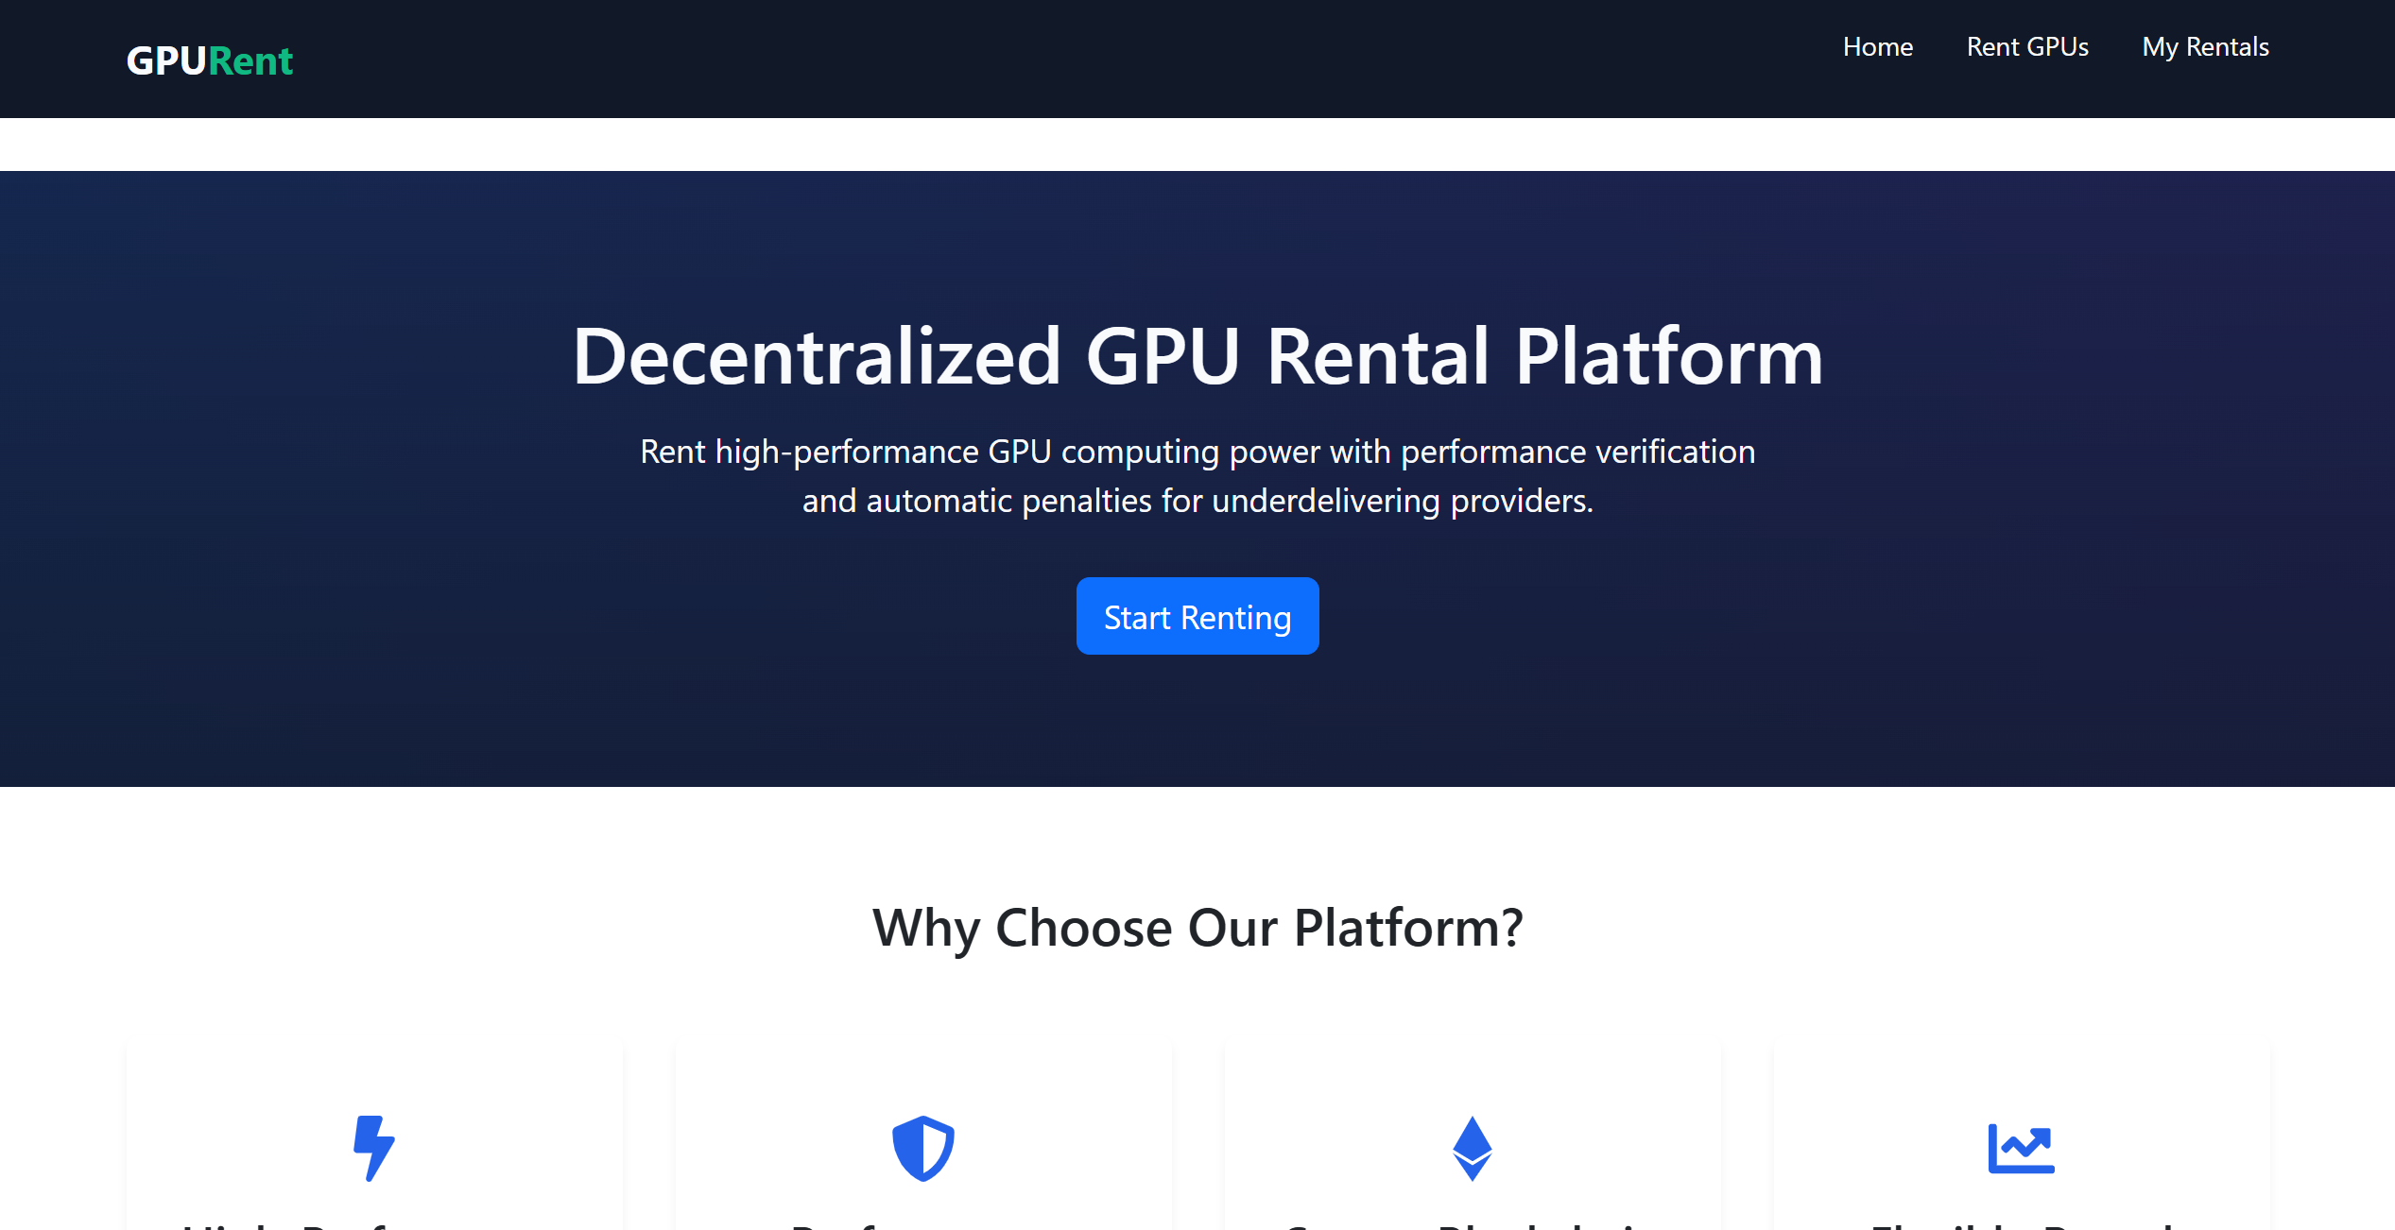


Live Demonstration
Now, Madhukar will walk you through a live demo of our platform!

Slide 7




